Slide 1

Sample Pitch Deck
Prof. Dr. Dietmar Grichnik

Slide 2

Intro
Sample Pitch Deck
State the date and occasion of the pitch.
Page numbers are also recommended.

Slide 3

Problem
Sample Pitch Deck
Describe the problem that your startup is solving.
Be precise. Use pictures or other visual elements to make your point.
If your market is dominated by existing solutions, show why they are insufficient.

Slide 4

Solution
Sample Pitch Deck
What is your solution?
Boil it down so that everyone understands your approach on one slide!

Slide 5
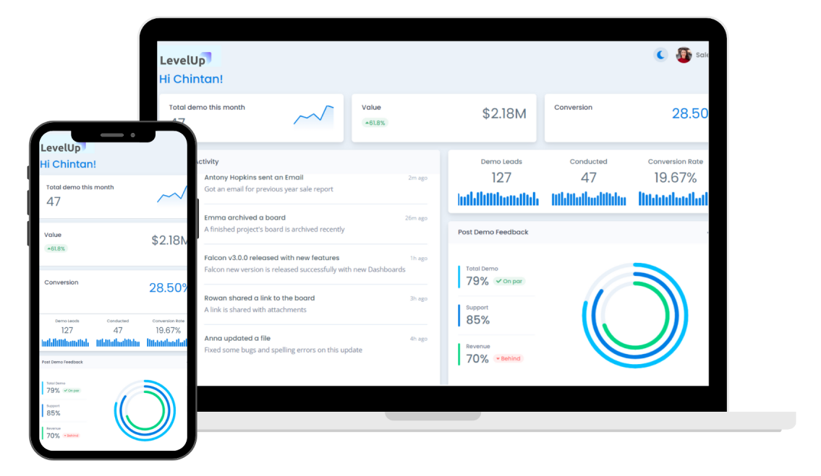
Product
Sample Pitch Deck
Show and explain your product or what you have built so far.
Also showing an MVP adds value.

Slide 6
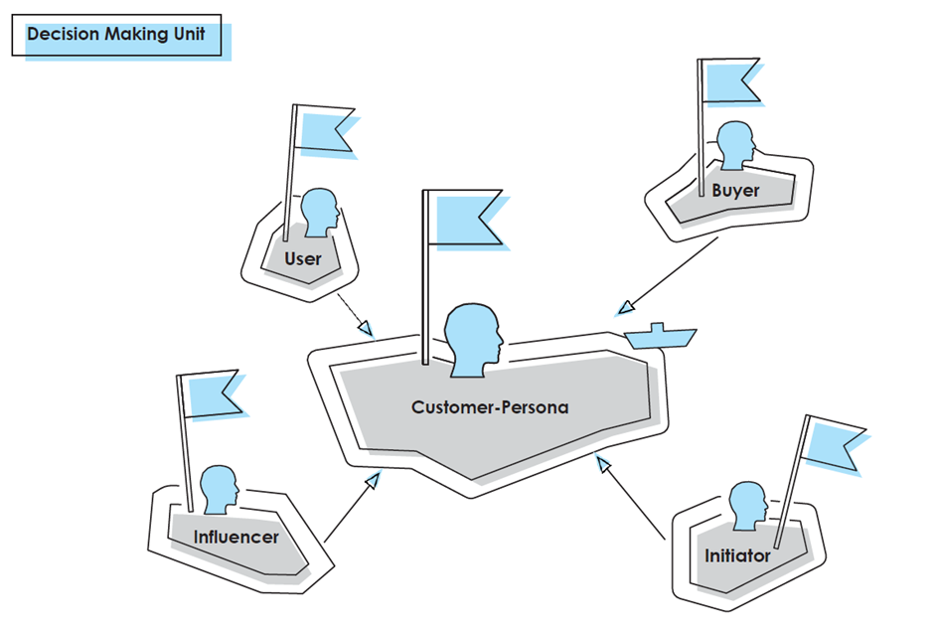
Customer and/or User
Sample Pitch Deck
Describe, who suffers the most from the problem you try to solve.
If you have users and customers, identify and describe both groups. Already hint what potential lies in that customer group and show, how you get them! If you already have prominent customers – drop some logos.

Slide 7

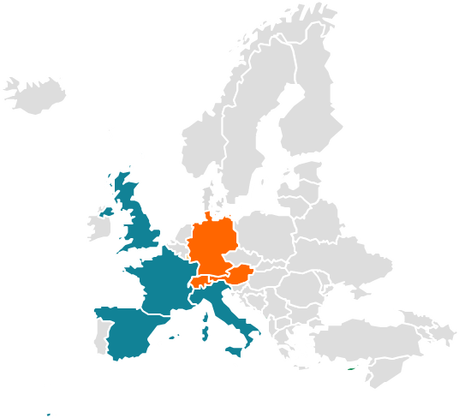
(Go-to-)Market
Sample Pitch Deck
It's best when you show that the market you address is big, growing, and has an international scope.
Also be sure to know the market you address in terms of characteristics, developments soon and any legal regulations.
Show how you want to capture it.
Size & Growth
Int. Scope
Entry Steps
Step 01…
€XXbn
Step 02…
Step 03…
€Xbn
Segment 1
€Xbn
Segment 2
Addressable markets
Active markets

Slide 8
Competition & USP
Sample Pitch Deck
Show your value propositions (VP) and compare it to your competitors.
Ideally, you have more VPs than the others. Name your USP and/or unfair advantage.
Competitor 1
Competitor 2
Competitor 3
Your Venture
Companies addressing similar markets
Value Propositions 1
X
√
√
√
Value Propositions 2
√
√
X
√
Put some logos here.
Value Propositions 3
√
X
X
√
Value Propositions 4
X
X
√
√
Value Propositions 5
X
X
X
√
Your USP

Slide 9

Team
Sample Pitch Deck
Show why you are the best team to bring this venture to success!
Also, you can show some logos of companies that you have worked with or where you have studied.
In case, you have already an advisor or even a whole board, name it.
Founders
Team
Name, Surname
CXO
Name, Surname
CXO
Name, Surname
CXO
Advisory
Board
Name, Surname
Current Job
Role as Advisor
Name, Surname
Current Job
Role as Advisor
Name, Surname
Current Job
Role as Advisor
Name, Surname
Current Job
Role as Advisor

Slide 10
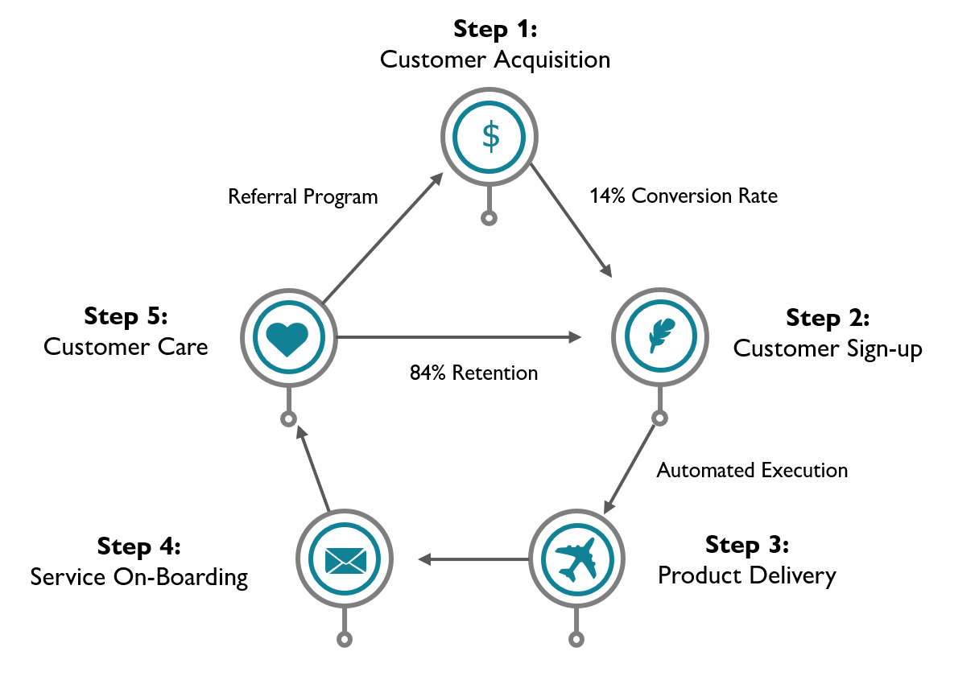
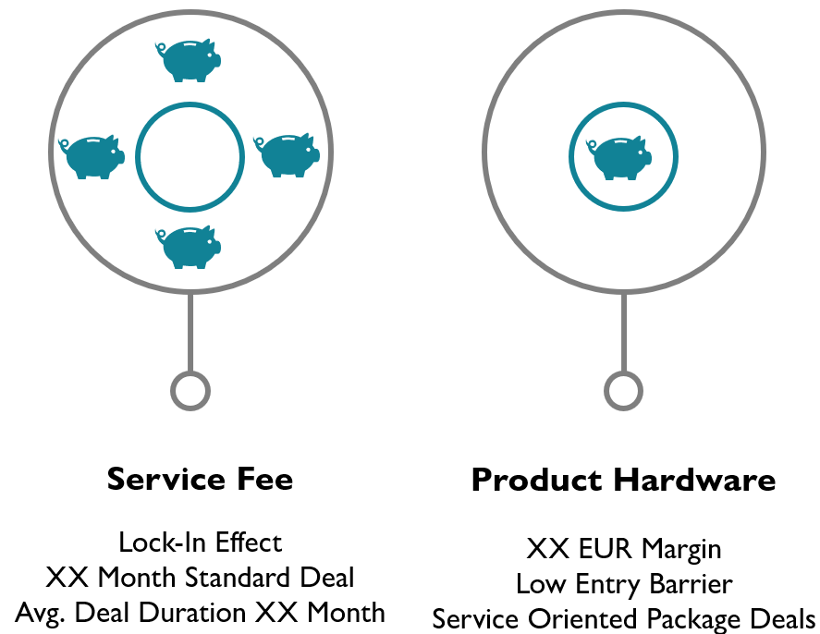
Business Model
Sample Pitch Deck
How do you earn money?
Who is paying how much for what? Use visualizations, value chains or process steps to make your revenue stream accessible.
Process
Revenue Streams

Slide 11
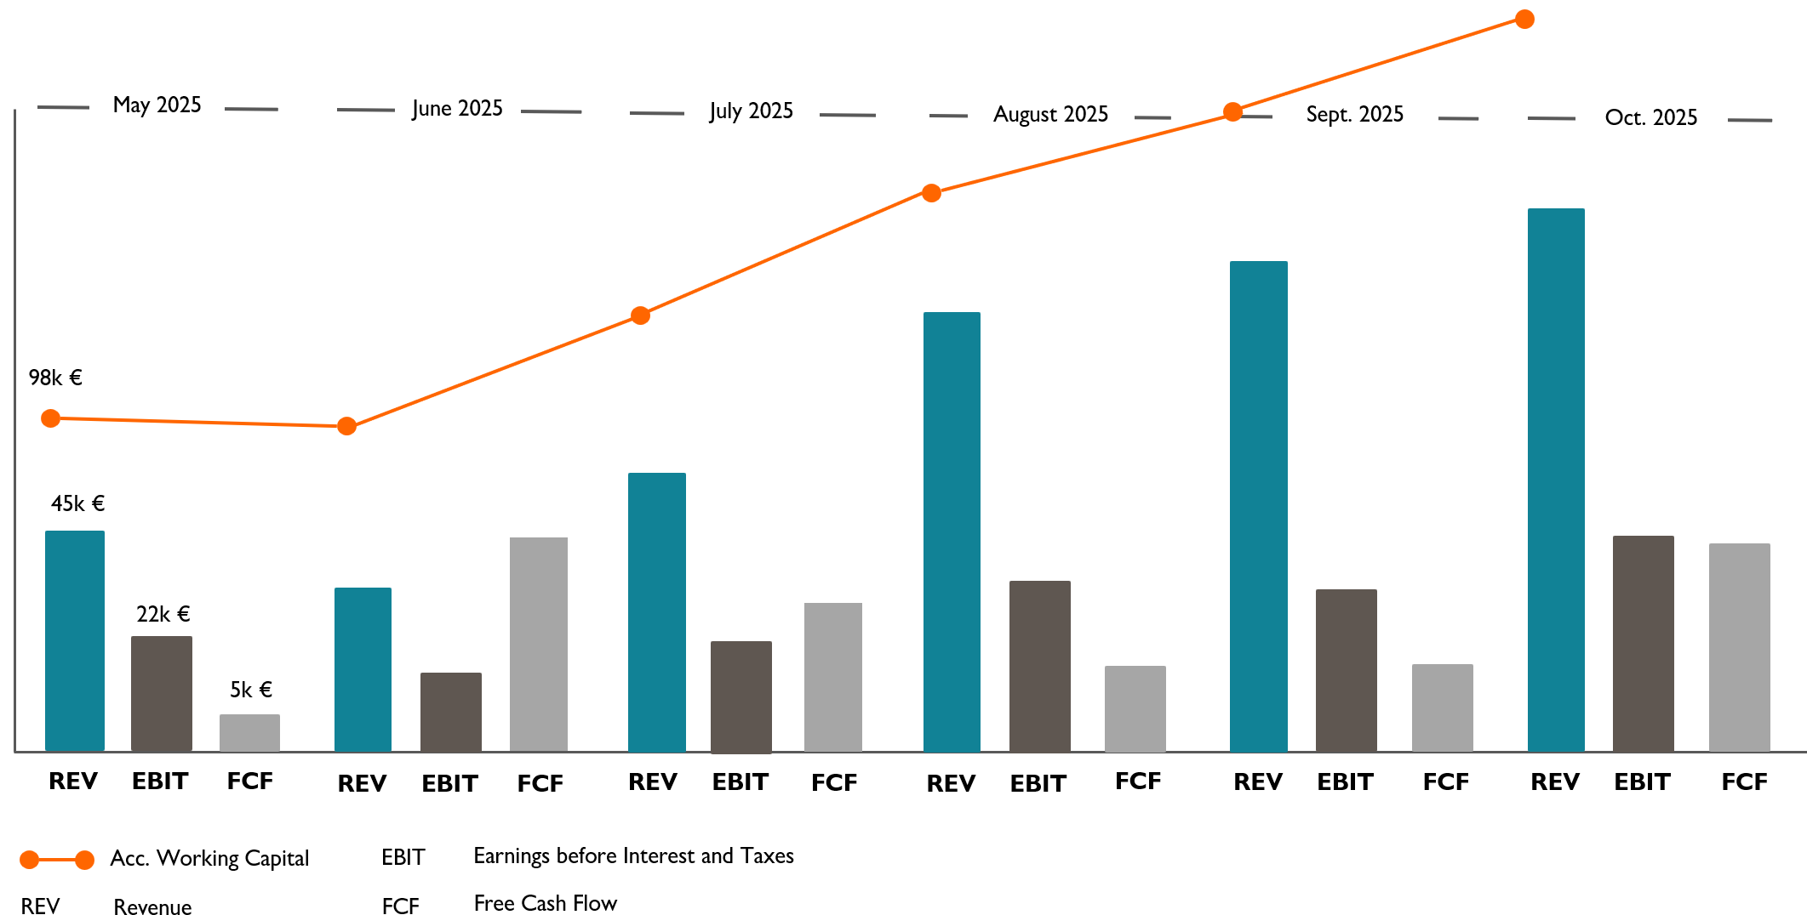
Traction
Sample Pitch Deck
If you have already achieved something – share it.
Choose 3-4 meaningful KPIs and provide a breakdown, if necessary.

Slide 12
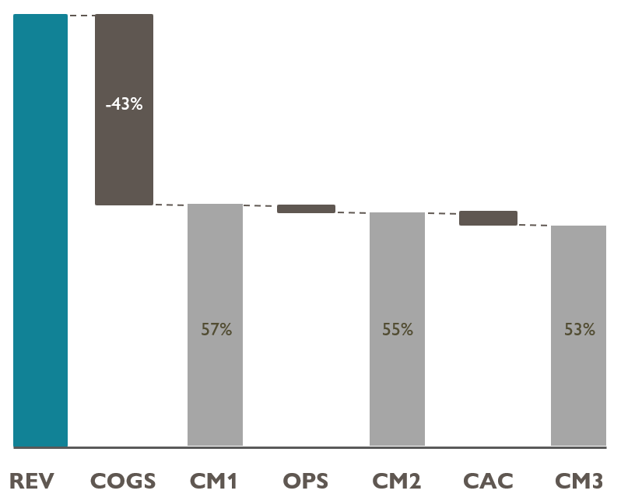
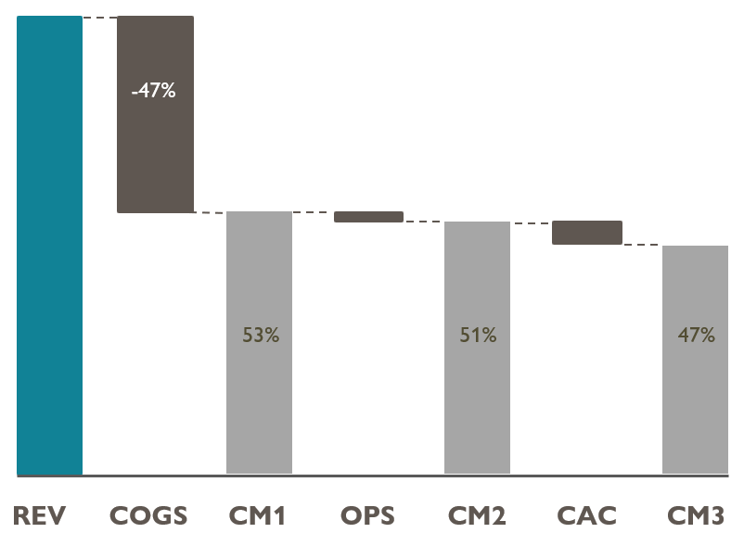
Unit Economics
Sample Pitch Deck
Show that you understand your Unit Economics!
Break each unit down to CM3 and demonstrate that you are ready to scale.
Sept. 2025
Oct. 2025
Lifetime Value
CLV
CLV Formula depending
on business model
€XX x XX years*
€XXX
*Lifespan calculated as: LS = 1/(1-Retention Rate)

Slide 13






Achievements & Roadmap
Sample Pitch Deck
Show what you have achieved so far and what you plan on doing next.
This should signal the upside potential and builds the bridge to the investment opportunity.
Achievements
Next steps
Short description of achievement 1
Next step 1
Short description of achievement 2
Next step 2
Short description of achievement 3
Next step 3
Good investors invest in upside potential not downside protection!

Slide 14
Investment & Deal
Sample Pitch Deck
How are your shares distributed so far?
Make sure to also include the use of funds of the new round.
Cap Table
Seed Investment:
Share how much money was raised so far. What have you achieved with this investment?
Current financing round:
Show the cornerstones of the current financing round. How much money are you looking for? How much has already been committed? Don’t talk about valuation here!
Use of funds:
Provide a good description of your use of funds. What will you spend the money for? What are quantifiable milestones that you would like to reach?
*Employee Stock Ownership Plan

Slide 15
Closing
Sample Pitch Deck
Do not forget to put your name & contact details!
Contact details
Mobile: +XX XXX XXXXX
Email: founder@yourstartup.ch
Website (Link)

Slide 16
Appendix
Sample Pitch Deck
Use the appendix for detailed explanations, financial fact sheets, IP protection excerpts,
additional product description and screenshots, etc.
APPENDIX

